Slide 1
Stage: Demo 3
Vic Rottiers

Slide 2
Stageopdracht

Slide 3
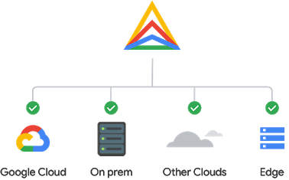
Google Anthos
Hybrid Cloud Management
Meerdere Cloud Platformen

Slide 4

Features
Multi-cloud Clusters
Config Management
VM Migration to Containers
Cloud Run
Service Mesh
Binary Authorization

Slide 5
Probleemstelling

Slide 6
Planning - Milestones

Slide 9
Praktisch

Slide 10
Lessons Learned

